Slide 1
1
Current context
2
Making this work - not easy!
* Mass of new media, online services, products and devices.
* Stay informed and make considered choices for your family.
* Attempt to think ahead to your child’s next request.
* Which routines will achieve the right balance for you?
* Keep dialogue open and try to remain interested!
Internet Safety for Parents & Carers
3
Tech preventions
4
Further points
* Router-level filtering
* Device-level filtering
* Apps to control content on children’s devices
* Social media controls
* Yet don’t be fooled into thinking you have solved the issue!
* Most of the time, don’t panic!
* Questions & Discussion
Giles Hill
Digital Strategy and Computing Lead

Slide 2
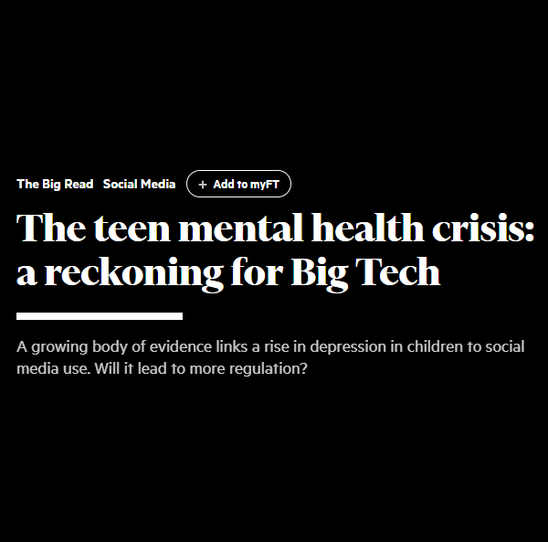
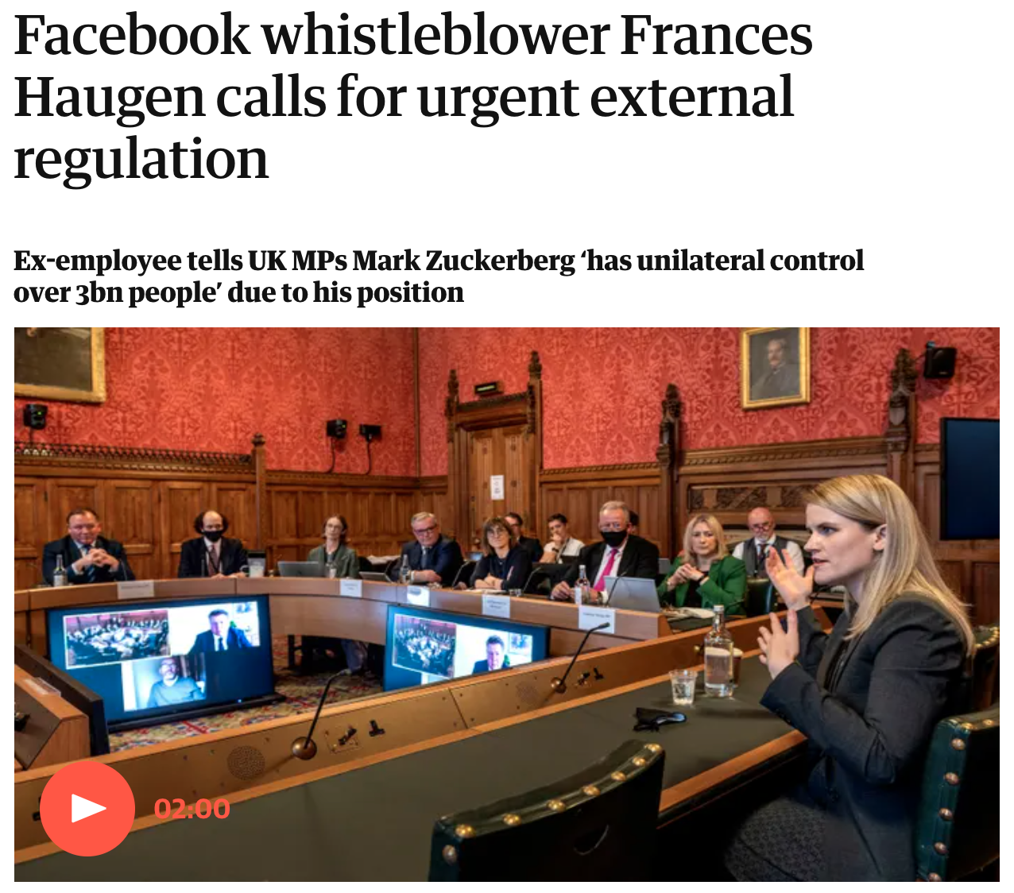
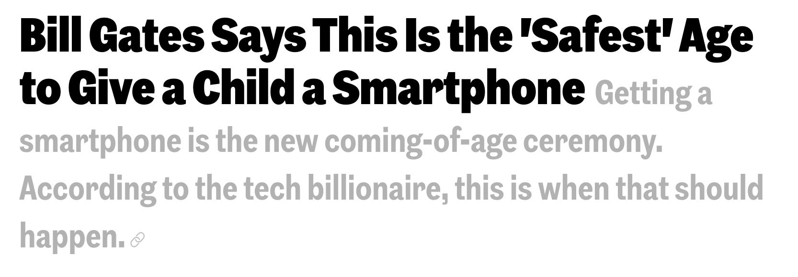
Current context of Internet Safety
Flood of systems and unregulated content have permeated into our lives over the last ten+ years.
A complex environment to navigate, yet do not dismiss your convictions and pursuit of making things work well for your family.
‘Screen time’ is a useful term but does also lack the nuance that we need. Some activities with screens could be regarded as very worthwhile and beneficial; many activities might also be thought of as a huge waste of time!
Physical and mental health are both factors that need consideration when planning for the best everyday balance for our families.

Slide 3
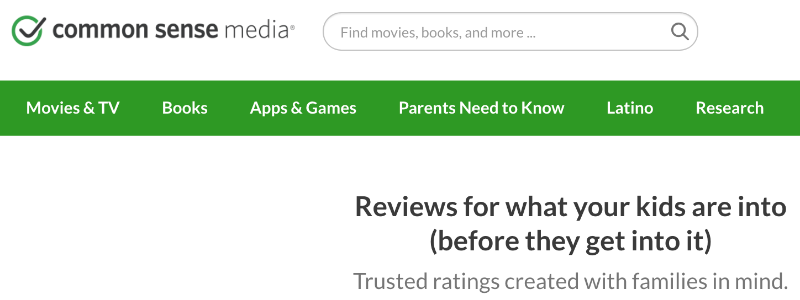
Making it work for your family
Routines, rules and structure - what is acceptable for your children? What will work well for you and your family to achieve balance?
Staying ahead of what your child(ren) may be asking about next - it is always worth staying in conversation with parents whose children are a little older than your own.
Stay aware of what your children are doing online - keep the dialogue open and honest if possible. Be available to your children for discussion and reassure them that if things go wrong, they can seek help from you.

Slide 4
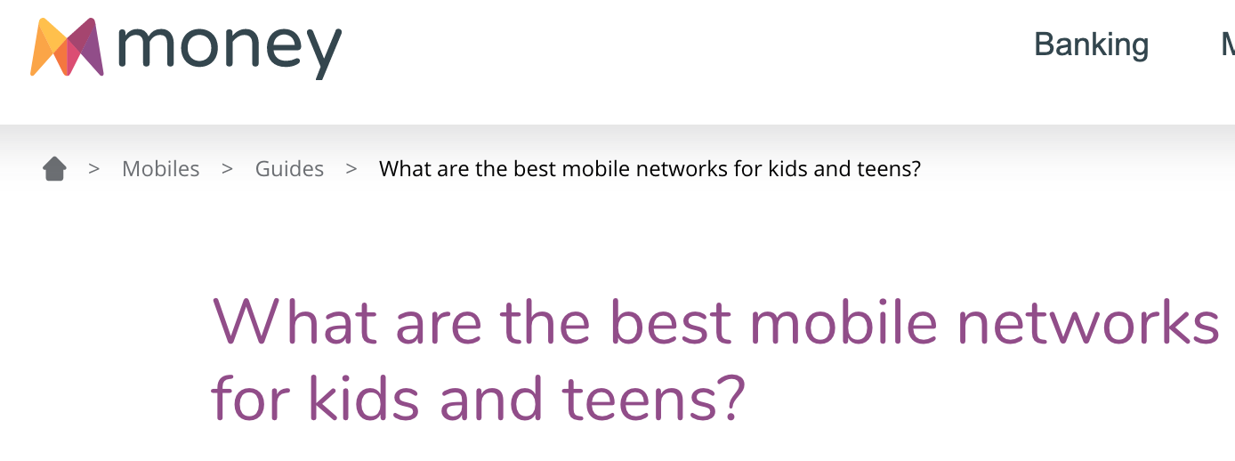
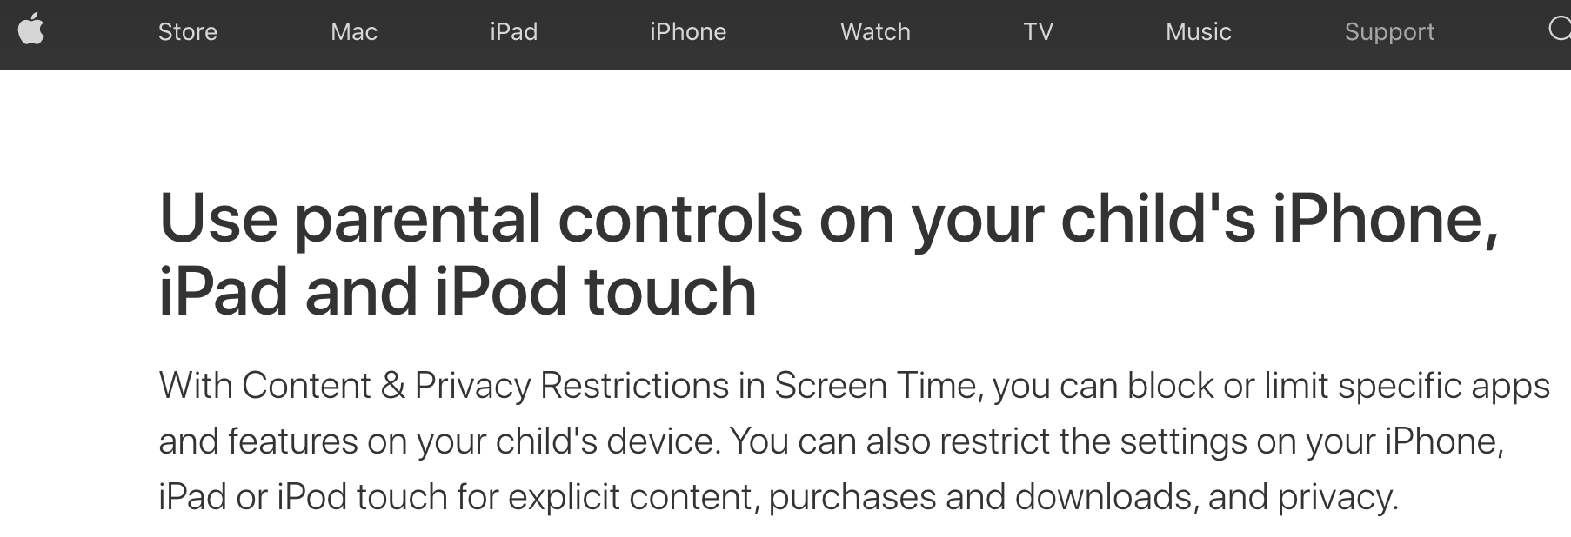
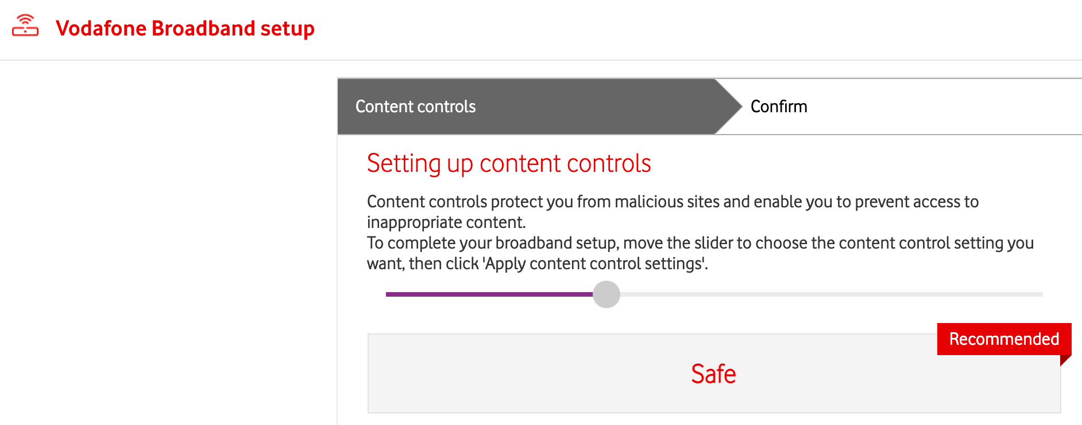
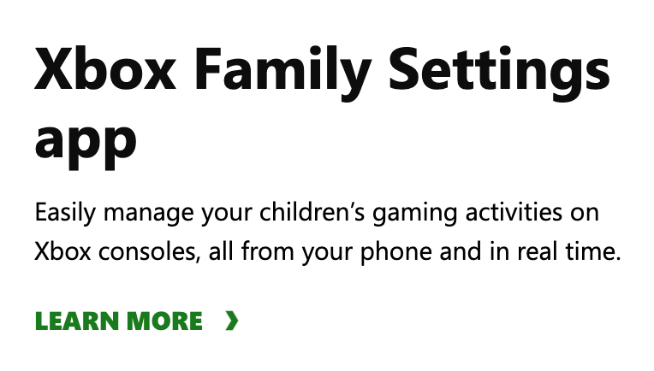
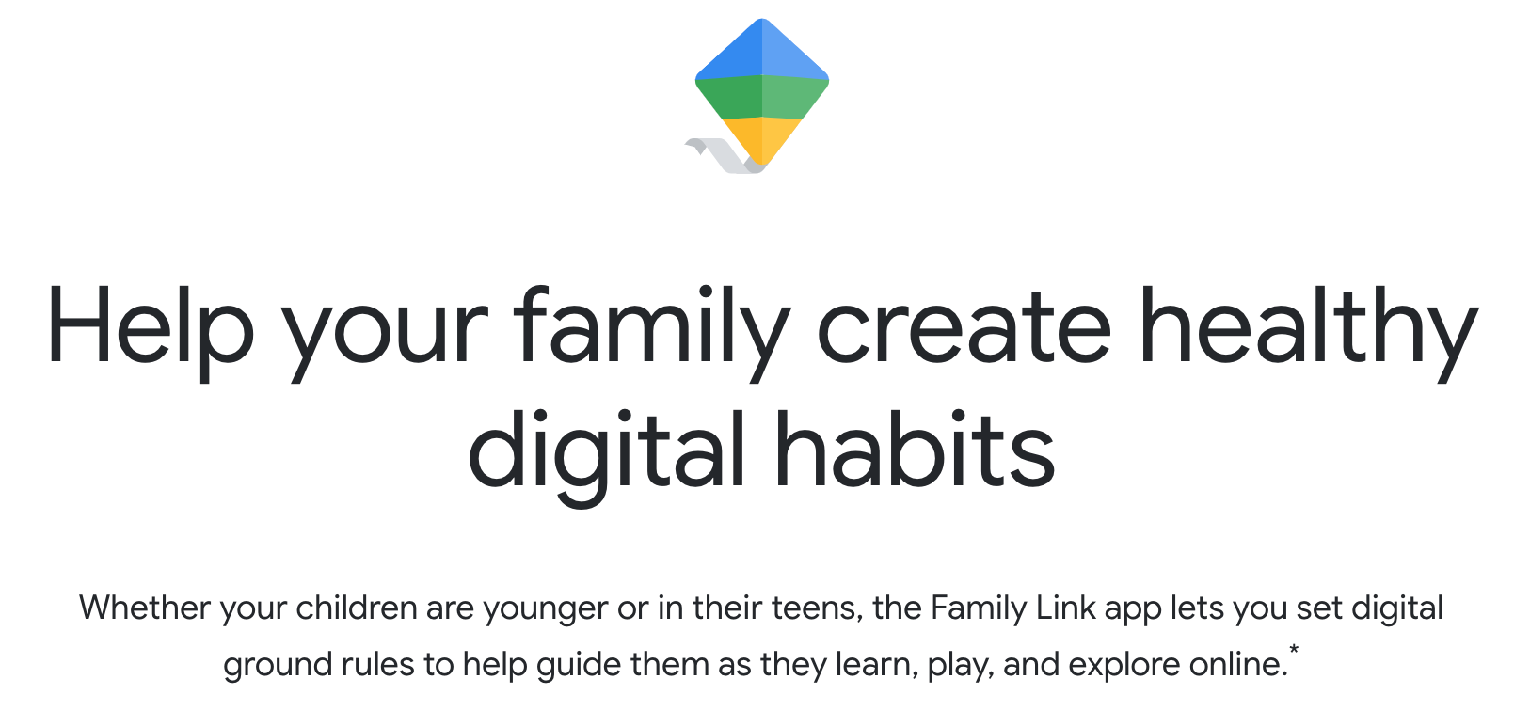
Tech-based preventions
There are lots of ways that devices and services can be limited so that children are kept within the boundaries that you set. However, this does not mean it is safe or desirable to think that you have solved all problems and can happily send children off to bedrooms with devices!
As technologies change, updates happen - and children become better at finding loopholes. It is always better to keep a child’s screen-based activity in-sight – and attempt to discuss matters with them regularly as children get older.
Filter at the router.
Filter on an account.
Filter on the device itself.
Settings within apps to increase safety.

Slide 5
Further points and discussion
Mostly, don’t panic! It can be easy to create hysteria and attention on particular services / programs / games with well-meaning, high-visibility warnings that end up creating further unnecessary attention.
Expect flare-ups every winter as children and adults spend more time indoors on screen-based activities.
No one gets everything right all of the time. Setting up regular, healthy routines that allow us to achieve a balance in our lives can be achieved. Try to be aware of the changes that happen as children get older, and attempt to stay ahead of those changes.
Dove social media campaign

