Slide 1
School Forum
22nd and 23rd March 2023

Slide 2
Agenda
SEND Referral Process
Parent Engagement Policy
Working Together Policy
Working Together Offer
Learning Fayre

Slide 3
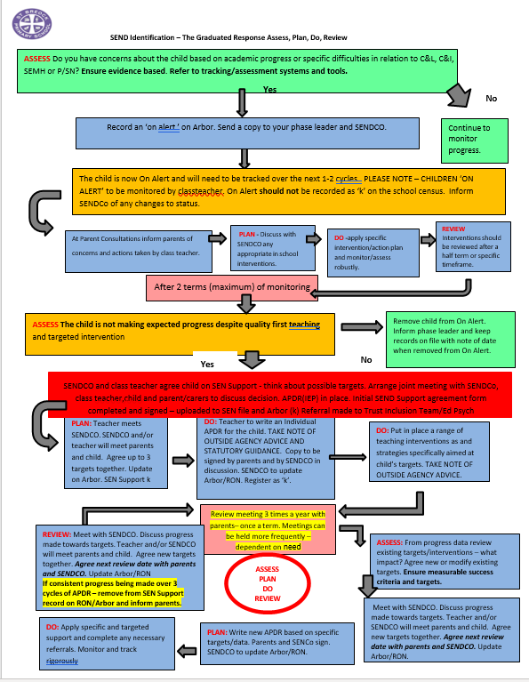
SEND Referral Process

Slide 4
The Four Pillars of Parent Engagement
Knowledge
Understanding of impact
Aware of the evidence
What does good engagement look like
Clear expectations referred to regularly
Environment
Safe and inclusive environment
Support on offer
Informal space/drop ins/coffee sessions
Culture
Positive
Trusted relationships & recognition
Active parents – PTA, Hub Councillors, Reps…..
Communication
Listening to needs and challenges
Shared plan
Communication training for staff
Support for communicating with children - checklist

Slide 5
The Importance of Parent Engagement
The effect of parental involvement at home - in particular the discussions and conversations parents and carers have with their children - was stronger than that of either socio-economic status or parents’ level of education. (Deforges 2003)
‘Parents can have a major effect in terms of the encouragement and expectations that they transmit to their children’. (Hattie (2005)
The importance of parent engagement in children’s learning is widely acknowledged (e.g. Goodall 2017), indeed the evidence suggests that it has many benefits, such as improvements in literacy and maths skills (Van Voorhis et al. 2013), better school attendance (McConnell and Kubina 2014) and closure of the achievement gap (Goodall 2017).

Slide 6
What is Parental Engagement?
Parental involvement most often focuses on parents getting involved in the life and work of the establishment
Parental engagement most often refers to parents’ engagement in their child’s learning at home, at school, and in the wider community
The movement between the two represents a ‘shift in emphasis, away from the relationship between parents and schools, to a focus on the relationship between parents and their children’s learning’ (Goodall and Montgomery, 2014)

Slide 7
Increasing parental agency | Parental involvement with the school |  |  | DeDecreasing school agency
 | Reading in class | Volunteering | Parents evenings
 | Parental involvement with schooling
 | Helping with Home Challenges | Regular Reading | Attending Learning Events
 | Parental engagement with learning
 | Moral support | Guidance | Attitude toward learning in the home
Notes:
Narrowing the achievement gap: Parental engagement with children’s learning Professor Janet Goodall (2017)
Continuum is cumulative – activities continue as progress through school.
The continuum begins with parental involvement with the school – volunteering, attending meetings – build/ cement relationship – not directly impact on learning – agency remains firmly with school, staff
Second level – shift balance towards learning – practice by parent that may require actual contact with the school. Takes place at home, outside of school and without direct intervention of school staff. Parents are more involved as agents but still dictated to by school staff and judged by them.
Beneficial for students ‘Daniel’ 2016 – positive associations between higher school based parental involvement and improved student success, particularly early years.
Arguably first two levels parental involvement will decrease as pupils get older – not diminished third level interactions will change in nature and content but the supportive nature of these exchanges should not be reduced.
Third level – firm base as deals with learning in the home
communication

Slide 8
Building Meaningful and strong relationships, and engagement with parents, families and the community the school serves:-
Direct learning support from parents can promote children’s learning outside of school. For example reading, language and number. For older children, support may be more motivational for example, showing an interest in school work, indicating its value.
The perception amongst students and their families that the school values and understands them may increase motivation, support high attendance, improve behaviour and promote engagement in learning in school.
Good communication and trust between school and community may enable to schools to receive and respond to feedback about how they can bettermeet the needs of students, as well as be aware of, and sensitive to, thewider issues of community.
https://evidencebased.education/school-environment-and-leadership-evidence-review/

Slide 9
How does this look?
Parent Engagement Framework – Parent’s Guide
Parent Engagement Policy
Calendar of Events

Slide 10
You said, so we did
One project a term with tips/Tapestry on a Friday
Top Tip
Communicate expectations through newsletter, parents evening and children
Next Steps;
What would support you to engage with learning at home?
A practical pack of resources
Learning Fayres
Parent Workshops
Family Workshops
Half Termly focus for reading with tips and activities.

Slide 11
Thank you

